Slide 1
Generalizing multistain immunohistochemistry tissue segmentation using one-shot color deconvolution deep neural networks
Amal Lahiani, Jacob Gildenblat, Irina Klaman, Nassir Navab, and Eldad Klaiman
Pathology and Tissue Analytics, Pharma Research and Early Development, Roche Innovation
Center Munich; SagivTech LTD., Israel; Computer Aided Medical Procedures, Technische Universität München, Germany
Presented by Michael Lan

Slide 2
Introduction
In cancer immunotherapy biomarker research, images of tumor biopsy slides are stained to show various parts of cells, enhancing certain regions to determine what is happening in the slide.
Eg) IHC staining can show if cancer cells have hormone receptors on their surface
Different types of stains show different results. Sometimes, a slide is stained with multiple types of stains.

Slide 3
Introduction
Researchers want to find patterns of changes in tumor biopsies image slides. But manual annotation of tissue slides is labor intensive and error-prone.
Aim of paper: Automation of this annotation process
This paper uses a novel one-shot color deconvolution deep learning method to automatically segment and annotate digitized slide images with multiple stainings into 4 categories

Slide 5
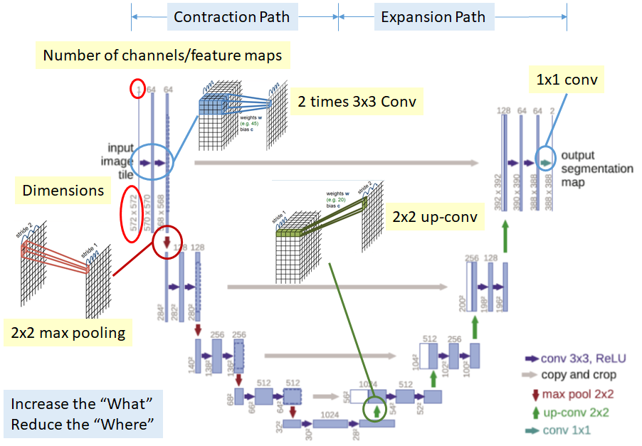

Slide 6
UNET for image segmentation
Downsample using conv and max pool to learn features and reduce feature map spatial size. This is the ‘label learning’ phase.
After learning features, upsample using up-conv and conv to recover spatial size. This loses localization info, so concatenate feature maps from the downsampling phase (gray arrows) to increase spatial size. This is the ‘segmentation labeling’ phase.
The last 1x1 conv maps feature map size 64 to 2 classes. Filter sizes can be adjusted according to # of classes required in output

Slide 7
UNET
First path is the contraction path (the encoder) captures the context in the image. It is a stack of convolutional and max pooling layers.
The second path is the symmetric expanding path (the decoder) which is used to enable precise localization using transposed convolutions.

Slide 8
UNET → CD-UNET
First trained 2 UNET networks on separate datasets: a single stain dataset, and a multi-stain dataset. UNET did well when trained on the single stain, but not on the multi-stain
This paper introduces CD-UNET, which adds a color deconvolution segment before UNET, to obtain a network that performs well when trained on a multi-stain dataset
Previous approaches required pre-processing of multi-stain images before training on them for networks to do well

Slide 9
Dataset
77 stained whole slide images of Colorectal Carcinoma metastases in liver tissue from biopsy slides. 51 slides used for training, 26 for testing.
Annotated regions with 4 categories: Normal tissue, Tumor, Necrosis (dead tissue), Excluded (irrelevant areas such as noise artifacts)
Areas not in these 4 categories are ‘background’

Slide 11
Dataset Pre-processing
Imbalance of the classes (58%, 19%, 16% and 7% for background, tumor, tissue and necrosis respectively)
Addressed this with a loss weighting strategy called median frequency balancing
To increase the amount of labeled data, used data augmentation techniques including hue, brightness and scale jittering, adding uniform noise to the intensity channel, random occlusion, image flips and random but small affine transforms.

Slide 12
Median Frequency Balancing
Weight each pixel by α(c) = median(freq) / freq(c)
median(freq) = median of pixels from ALL IMAGES in dataset
freq(c) = $\frac{\text{\# }\text{pixels} \text{of} \text{class} \text{c} \text{from} \text{all} \text{images}}{ \text{total}\text{ \# }\text{of} \text{pixels} \text{from} \text{all} \text{images} \text{with} \text{c}}$

Slide 13
Vector Representation & Loss Function
The input images are BGR 512 x 512 images scaled to the range [0, 1], and the outputs are 512 x 512 x 4 images, where each pixel contains a vector of four probabilities for each class
The loss function is cross entropy loss

Slide 14
Optimization Details
Optimization: Synchronous SGD with a momentum of 0.9
Synchronous SGD speeds up training on multiple GPUs
15 GPUs with total batch size of 240 (16 per GPU)
The base learning rate of the SGD optimizer was multiplied by the # of GPUs; 0.001 was the default learning rate for 1 GPU
Distributed training done using PyTorch
10% of the training data was reserved for validation, which was done with F1 scores every 10 epochs

Slide 15
One-Shot training
One-shot learning aims to learn information about object categories from one, or only a few, training samples/images.

Slide 16
Training & Validation
Trained UNET with 2 different datasets: 1) Contains only one staining called H&E and 2) Contains different staining types (H&E AND 8 additional staining types)
Validation F1 scores of the different classes converge smoothly during training after 200 epochs for dataset 1, but did not converge smoothly or to the same levels for dataset 2
This difference is most strongly expressed for the classes of necrosis and background

Slide 17
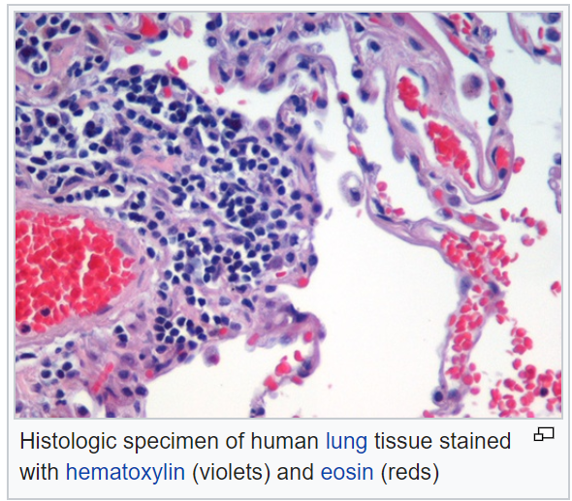
Single Stain
H stains basic structures
E stains acidic structures

Slide 18
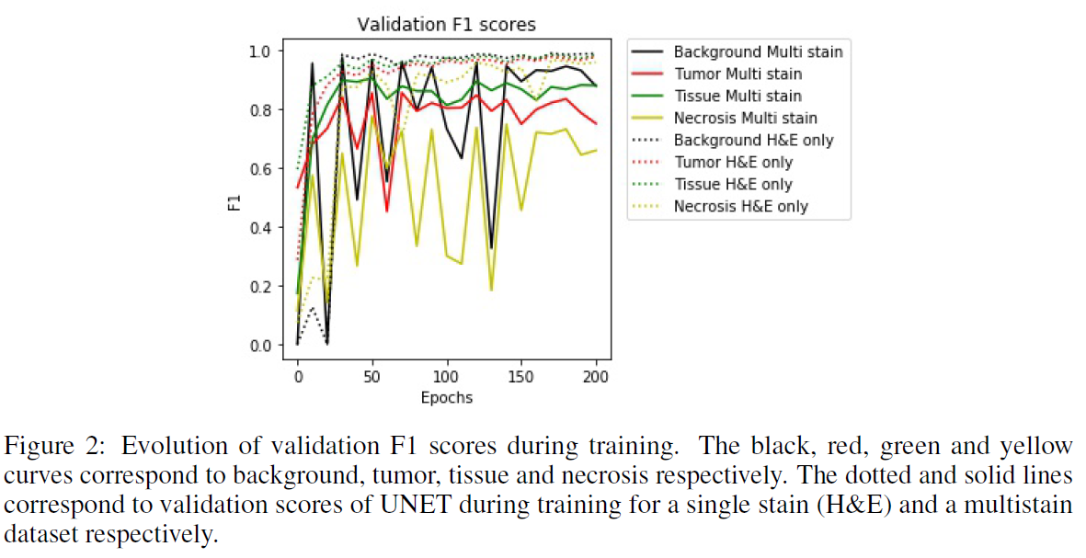

Slide 19
Testing Results
Both networks were tested on the same dataset, which only contained H&E images
H&E network showed better generalization than Multistain network in 3 categories

Slide 20
Why the bad performance?
Theory: images of slides with multiple stainings in the training dataset make it harder to learn the correct features of the different classes due to increased dataset and intra-class variability
Instead of passing in RGB pixel values, pass in stain concentration values

Slide 21
Previous Work to Address Issue
Previous work addressed this issue by pre-processing multi-stain images. However, this pre-processing is subjective and thus can vary depending on the lab that does it, resulting in inconsistencies
In Duggal et al, a stain separation layer was added to the network, but it still used a pre-processing step to estimate the optical density from the raw image. Also, this method relied on initializing parameters the stain separation layer based on stain parameters, which is still subjective

Slide 22
CD-UNET
This paper addresses this problem by adding a color deconvolution segment to UNET to create CD-UNET
Color deconvolution parameters are learned as part of the segmentation network without the need to pre-process the images
This is the first work in which a color deconvolution was learned as part of the network without pre-processing

Slide 23
Color Deconvolution Segment
This color deconvolution segment has two 1x1 convolution layers that are followed by ReLU and batch norm. First layer has 6 filters, each for a different stain color. Second layer has 3 filters to output feature maps that are the same size as the inputs

Slide 24
UNET in CD-UNET
The UNET is fully convolutional and outputs a pixel wise segmentation of the input. All conv layers had zero padding to preserve spatial size. This UNET is also smaller; each layer has half the number of filters compared to the original, which spends up learning and reduces overfitting

Slide 25
Nonlinear Functions in Color Deconv
Each of the convolutional layers in this color deconvolution segment is followed by a nonlinear function that is meant to learn how the observed pixel intensity It varies non-linearly with the concentration of staining
The network will learn the relation between how much concentration of staining there is in that pixel and pixel intensity, which is used in segmentation
This non-linear relation is due to the Beer-Lambert law

Slide 26
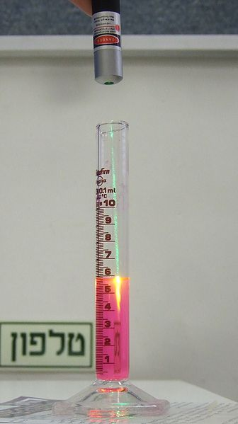
Beer-Lambert law
OD: optical density (how much light passes through)
I0 is the intensity of the incident light
It is the intensity of the light after passing through the specimen
Epsilon is the absorption coefficient
C is the concentration of the absorbing substance
L is the thickness of the specimen

Slide 27
Training & Comparing
Trained both UNET and CD-UNET for 200 epochs on the same multi-stain dataset, computing F1 validation every 10 epochs.
F1 scores for CD-UNET converged faster, suggesting faster learning

Slide 28
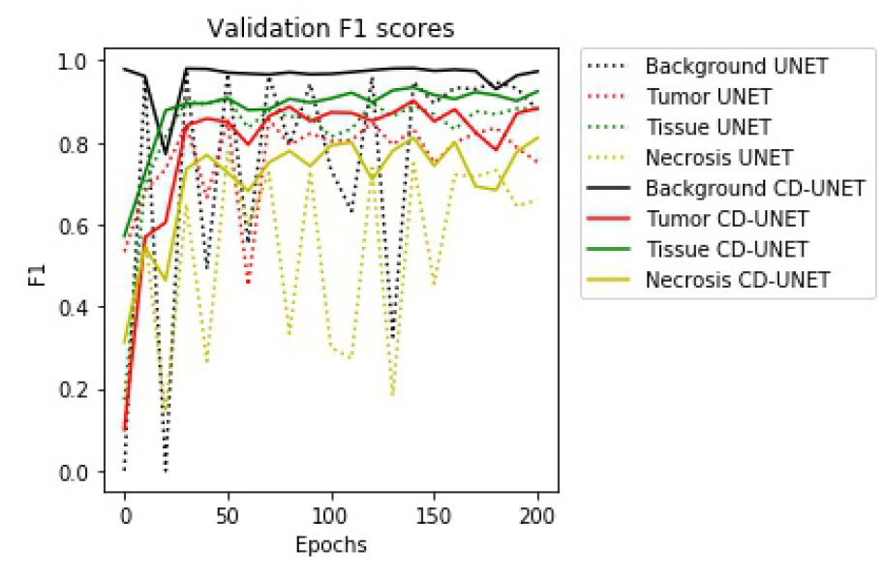

Slide 29
Testing & Comparing
Tested both on the same 26 images. F1 scores were higher for CD-UNET, suggesting better generalization

Slide 30
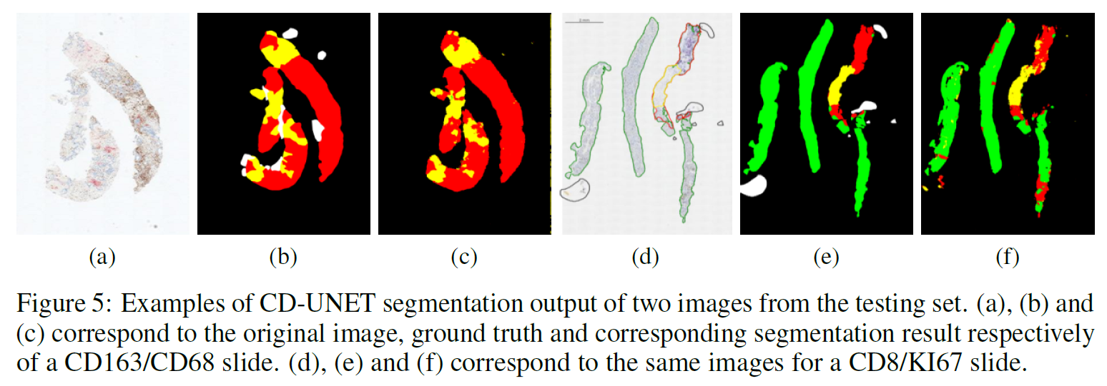

Slide 31
Feature Maps of CD-UNET
To show the effect of the color deconvolution segment, its feature maps using different stains (H&E and IHC) were visualized
The visualization of the outputs of the color deconvolution segment using different stainings as inputs shows the added layers actually learned to separate between different stain channels for the different stain types

Slide 32
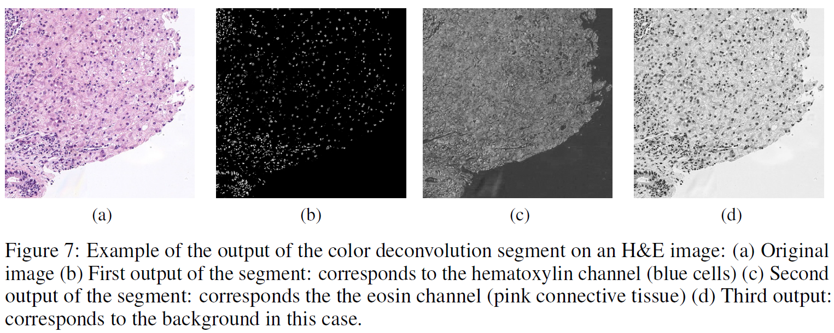

Slide 33
Feature Visualization in Segmentation
Feature visualization highlights pixels in the image and hidden layers that were significant for the network’s output. This helps medical experts understand which parts of an image influenced a network to make its decision

Slide 34
Feature Visualization in Segmentation
A noise image is inserted to the network, a specific pixel “receptive field” and category in the network output is set as the target, and several iterations of gradient ascent are run in order to modify the input image pixels to receive a high value in the target pixel receptive field.
Using this we can create examples of input images, that cause a high activation at the target pixel receptive field for each of the categories

Slide 35
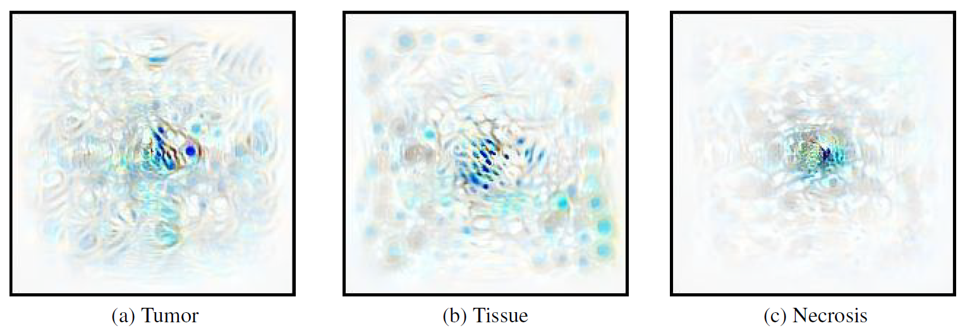

Slide 36
Feature Visualization in Segmentation
The area of the pixels in the input image that affect an output pixel (the effective receptive field) is different for the three categories
The tissue category score is maximized when there are tissue cell nuclei far from the target pixel, implying that patterns of multiple tissue cell nuclei around the target pixel are used by the network as clues of tissue presence
The tumor and necrosis categories look for patterns of condensed large distorted cell nuclei around the target pixel

Slide 37
Activation Maximization on Filters
To see the effect of the color deconvolution segment on input images, applied activation maximization on 1st layer’s filters.
A noise image is inserted to the network, and several iterations of gradient ascent are run that modify the input image to maximize the response of each of the filters

Slide 38
Pixel Attribution
For pixel attribution we used the SmoothGrad technique, and averaged the gradients of the category score with respect to noisy input image pixels. The gradient image was passed to a ReLU gate, to keep only positive gradients
The gradient image is then thresholded, and input image pixels that had gradients below the threshold were masked out, to keep only pixels that were important for the network decision. This shows an effective receptive field

Slide 39
Pixel Attribution
For several visualizations of tissue and tumor, the gradients highlight respectively healthy looking and tumor cell nuclei in the target pixel surroundings, while ignoring other textures
The thresholded effective receptive field was different between the different categories. The tissue category has a large effective receptive field compared to tumor and necrosis, which is consistent with the interpretation of the synthetic images maximizing the scores of the classes

Slide 41
Conclusion
This is the first work where multiple stains were simultaneously used in order to train a unified segmentation model that deals with multi stain histopathology images
Theory: the color deconvolution segment allows the network to deal with the variation of the input in the first color deconvolution layers and leaves the "rest" of the network with a much easier task to learn.

Slide 42
Future Work
To observe the effects of color deconvolution segments in other deep learning architectures and for additional digital pathology tasks, e.g. cell detection and classification
Additional variance capturing segments could be designed to help reducing dataset complexities from other sources, like different tumor and tissue types, to improve inference when image sources are not known or when staining/imaging quality is suboptimal.

Slide 43
END

